Slide 1

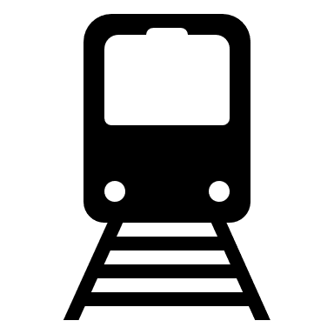
The architecture of the Moscow metro
Kuznetsov A.A.

Slide 2
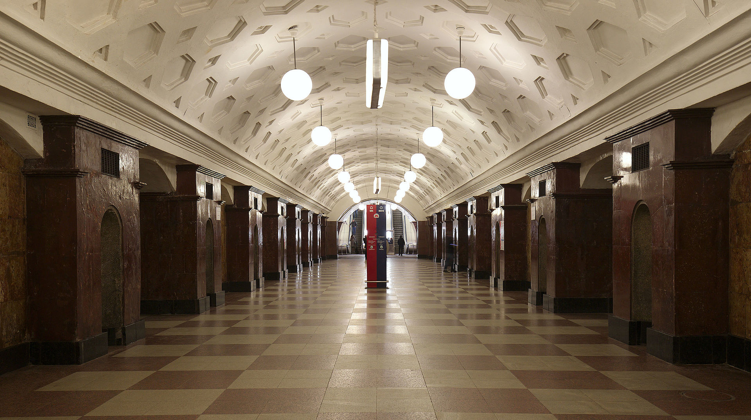
The Moscow metro is considered one of the most beautiful in the world. The metropolitan subway was the first where the station not only served as a service transport function, but also became real museum halls.
Architects Ivan Fomin and Nikolay Andrikanis. The project of the metro station "Krasnye Vorota"
In this type of station, the outer tubes (which house the tracks and platforms) are separated from the larger central hall by heavy pylons.
Krasnye Vorota has off-white tiled walls and pylons faced with dark red Shrosha marble from Georgia. A model of the station was exhibited at the 1938 World's Fair in Paris, where it was awarded a Grand Prix.
Kuznetsov A.A.

Slide 3
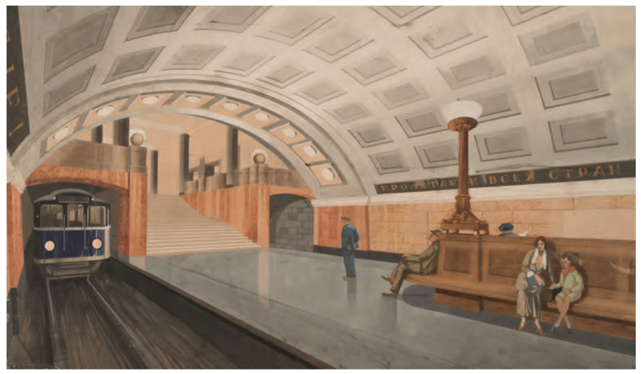
First stations of Moscow metro were built at 1931-1935. The approach to the design of the stations was serious - human development of near-Earth spaces became one of the symbols of life, a manifestation of its hitherto unseen possibilities in the form of a developing socialism.
Architects Аlexander Гонцкевич, С. Сулин.
The project of the metro station "Biblioteka im. Lenina"
The main station vault was built from rubble stone set in concrete and reinforced with an iron framework. This was lined with an "umbrella" of bitumen-coated paper to prevent groundwater from seeping into the station. The station was finished with plaster, yellow ceramic tile, and marble.
Kuznetsov A.A.

Slide 4
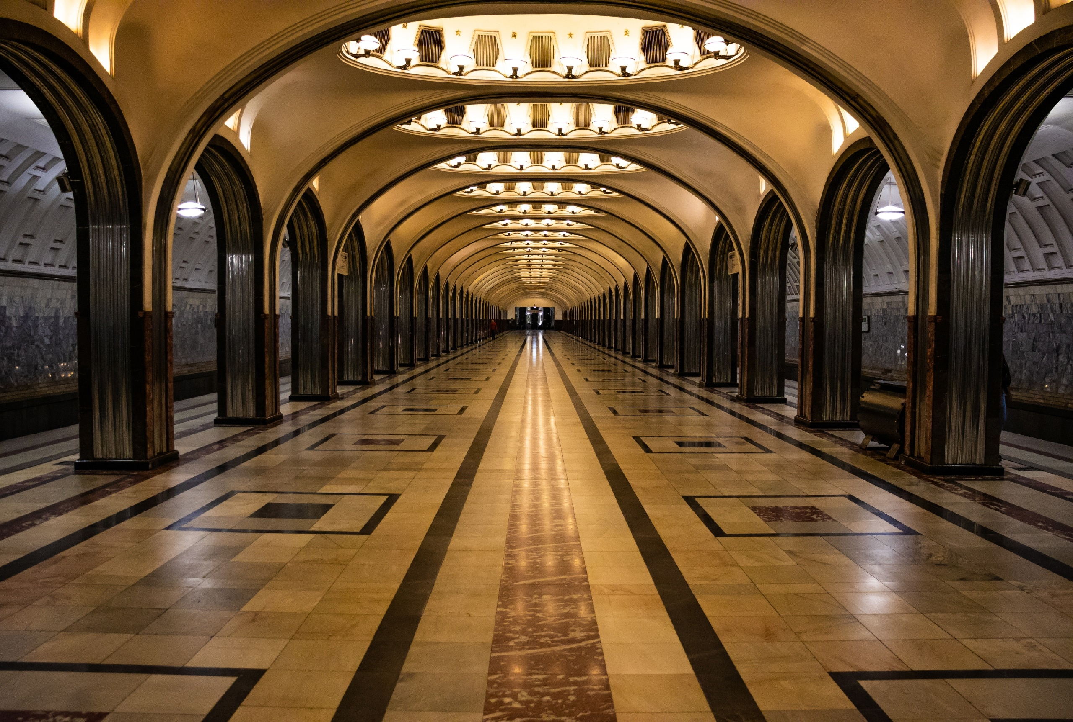
If the first stage was more focused on the building of the system itself, both architecturally and in terms of the engineering, the stations appear modest in comparison to those that the second stage brought to the system.
Architect Аlexey Dushkin.
The project of the metro station " Mayakovskaya "
For the first time in the world, instead of having the traditional three-neath pylon station layout, the engineers were able to overlap the vault space and support it with two colonnades, one on each side. This gave birth to a new Deep column station type design, and Mayakovskaya was the first station to show this.
Kuznetsov A.A.

Slide 5
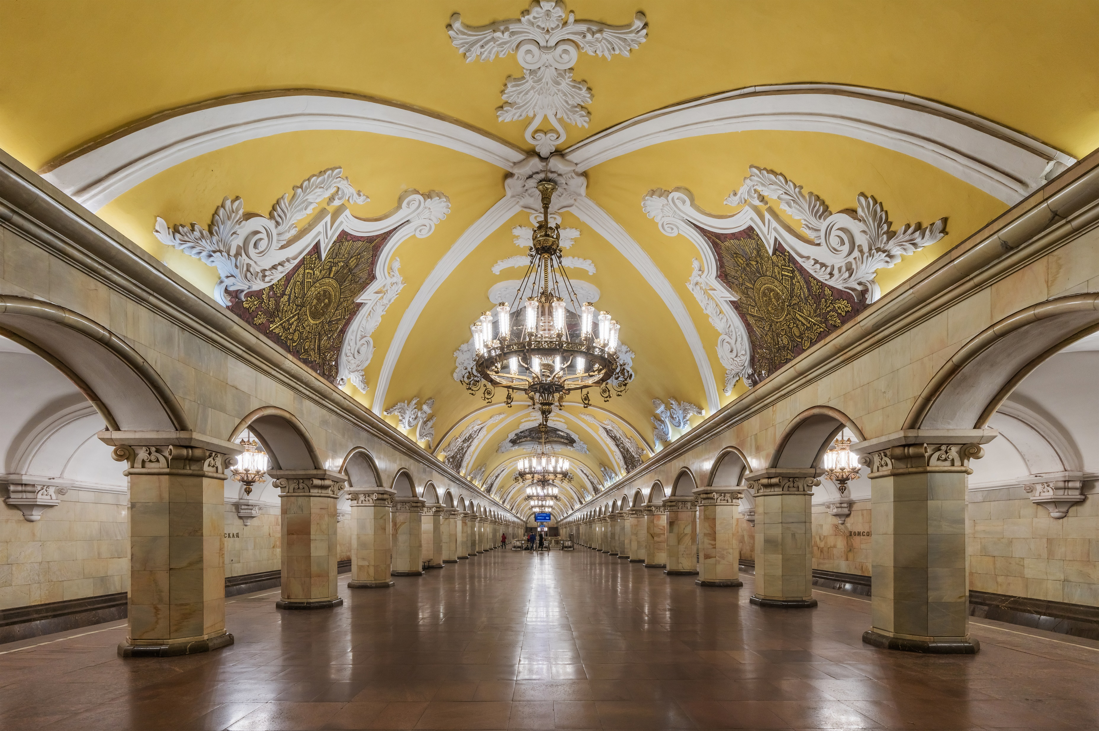
On the platform level, there is a Baroque ceiling, with accompanying friezes, painted yellow. Supporting the enlarged barrel vault are 68 octagonal columns faced with white marble, and topped with baroque pilasters. The platform is lit up by chandeliers and additional concealed elements in the niches of both the central and platform halls.
Architects А. В. Щусев, В. Д. Кокорин, А. Ю. Заболотная, О. А. Великорецкий, А. Ф. Фокина. Metro station "Komsomolskaya (Koltsevaya line) "
The theme of the design, the Historical Russian fight for freedom and independence, is expressed in eight large ceiling mosaics by Pavel Korin.
Kuznetsov A.A.

Slide 6
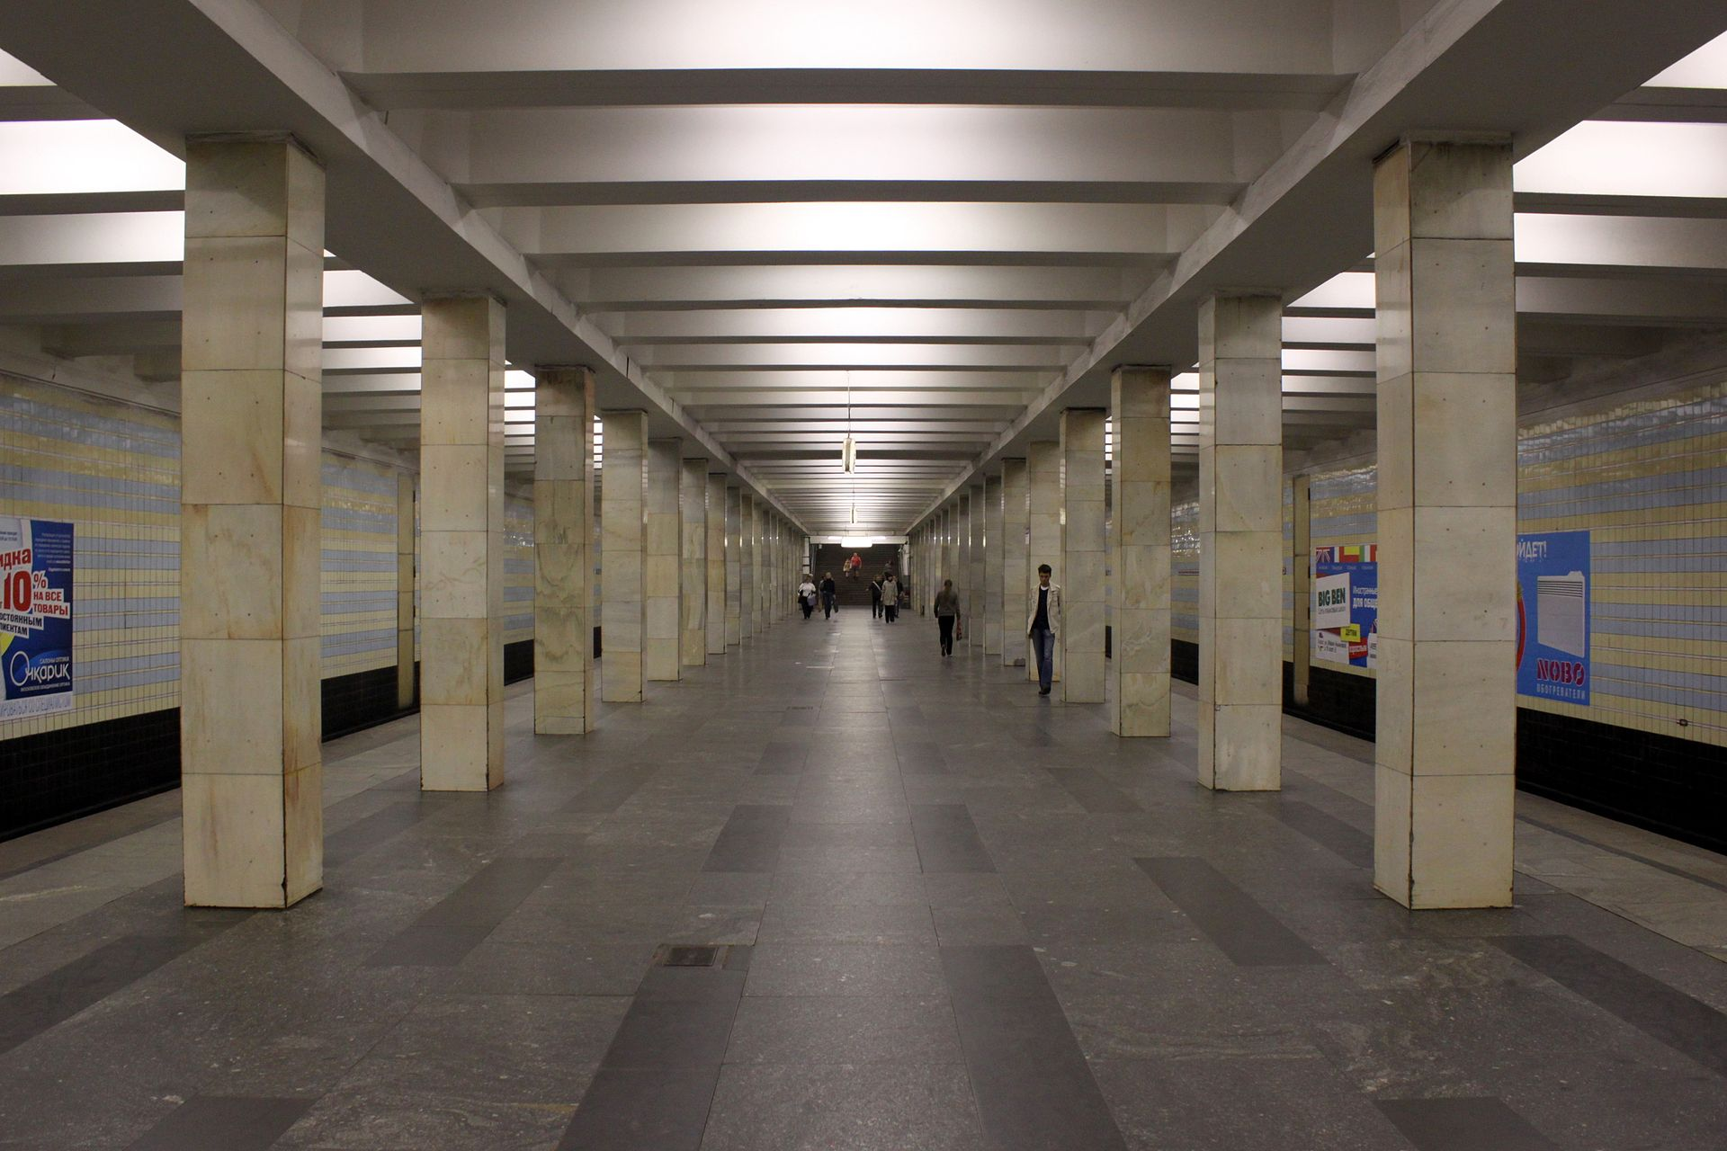
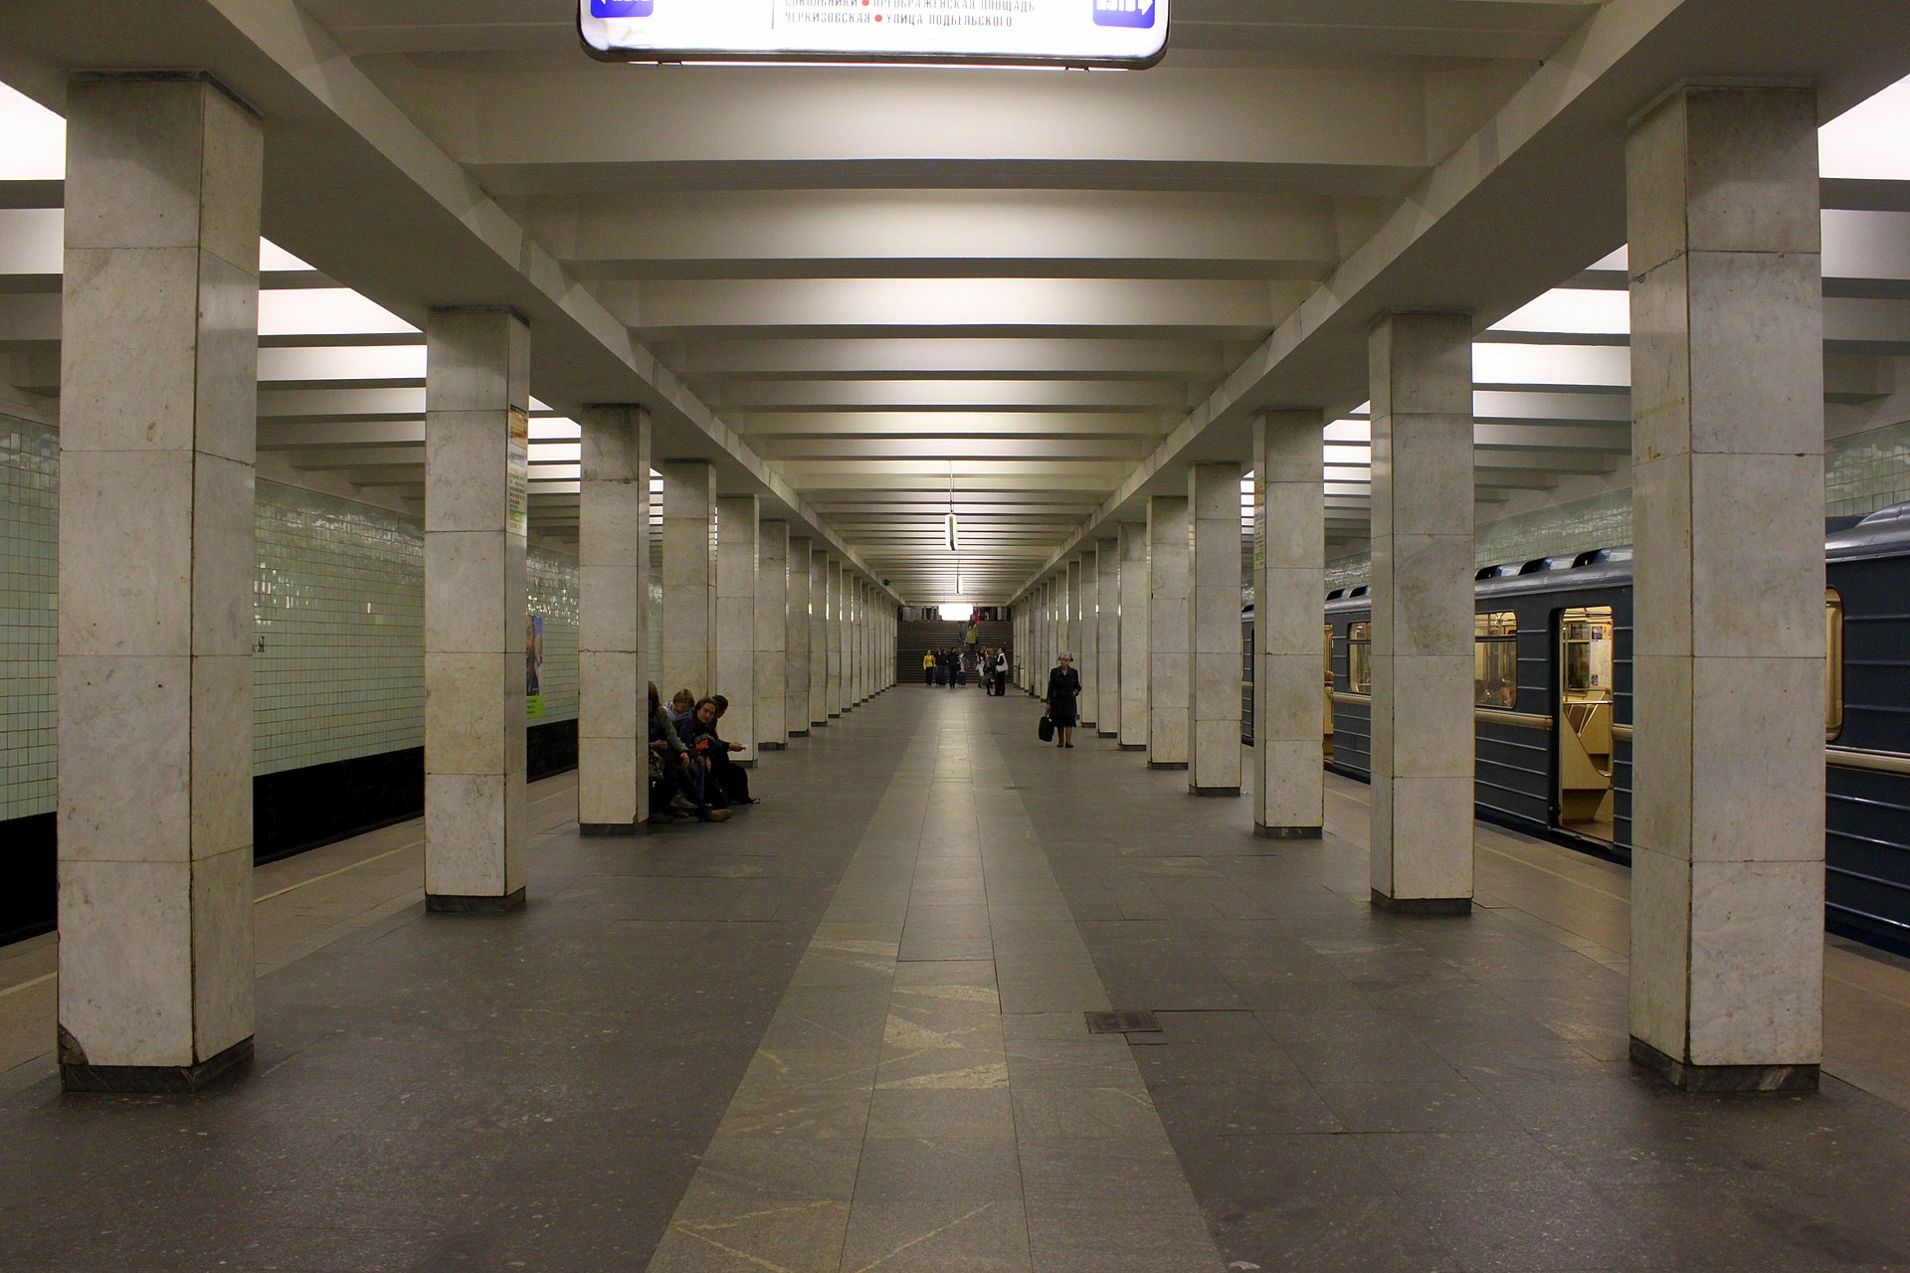
Since 1955, in connection with the resolution of the Central Committee of the CPSU and the Council of Ministers of the USSR "On the elimination of excesses in design and construction", the emphasis in the development of the subway was placed on increasing the pace of construction by reducing the cost of building stations. They began to allocate a certain amount for each station, and it was necessary to meet it. From expensive individual projects of each station, they began to move on to cheap standard projects.
Architects Ivan Taranov and Nadezhda Bykova, Ya. V. Tatarzhinskaya. Stations
“Prospekt Vernadskogo” and “Yugo-Zapadnaya”
Kuznetsov A.A.

Slide 7
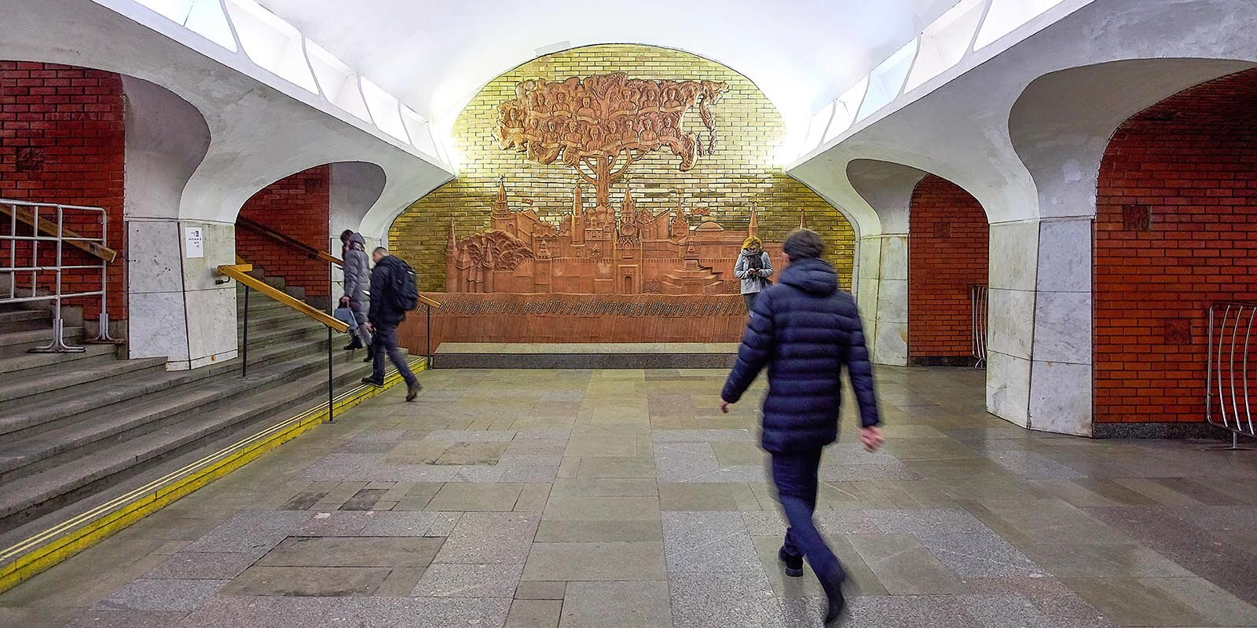
In the 1970s, a third way was proclaimed - it was decided to choose the best of the two previous observations. From the first - individual style, and from the second - industry connection methods and high rates of construction.
Architects Л. Н. Попов, В. С. Волович, Г. С. Мун. Metro station "Borovitskaya "
The columns and part of the vestibule walls are lined with white marble from the Koelga deposit. The wall in the vestibule above the arch of the escalator passage leading to the Borovitskaya station is lined with branded red brick, similar to the lining of the passages between the pylons at the station itself, in addition, an engraved panel depicting a golden fan of sun rays is fixed on it. On the opposite wall is a majolica portrait of V. I. Lenin
A large ceramic panel dedicated to the friendship of the peoples of the Soviet Union (artist I. V. Nikolaev). The panel depicts a tree with a crown in the form of a map of the USSR, growing from the Moscow Kremlin.
Kuznetsov A.A.

Slide 8
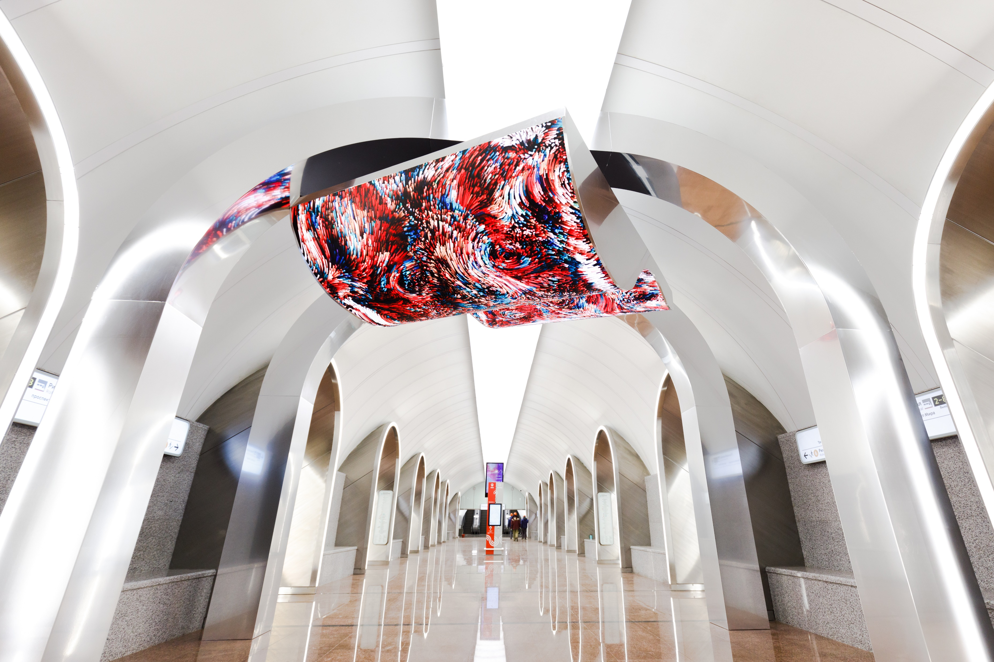
The modern concept of the Moscow metro comes from the fact that it is not necessary to hear the announcer's announcements or read the name of the station. When the train emerges from the tunnel, the passenger understands by the outline of the station whether he should leave now or not.
Metro station "Rizhskaya (Bolshaya Koltsevaya line)"
The architectural appearance of the station was chosen during voting on the Active Citizen portal, the results were summed up on June 13, 2017. The main element of the design of the station is a repeating arch in the design, which implements the concept of "portal to the city". The station design was developed by Blank ARCHITECTS (Russia)
Kuznetsov A.A.

Slide 9
Thanks for your attention!

